Slide 1
DataLab Analytics Work Experience and Certification
DATA SCIENCE INTERNSHIP PROJECT
PROJECT TITLE : A BOOK SUBSCRIPTION PLATFORM
(LIVEBOOK)
Project Supervisors: Oyeleke Yemi, Comfort Godwin & Ezinwanne Aka
DAVIS FAVOUR ADENIKE
TEAM ACHIEVER
APRIL, 2023

Slide 2
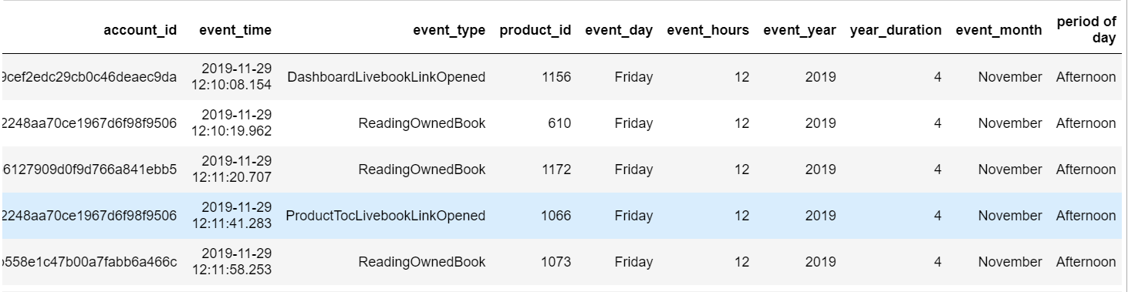
INTRODUCTION
Welcome to our data analysis presentation on a book subscription platform (livebook), In this presentation, we will explore the time series indicators of customer engagement with our books subscription platform, and use predictive analysis techniques to forecast the possibility of next subscription. Let's dive into the data and uncover valuable insights!
DATASET OVERVIEW
Our dataset consists of customer data collected within the period of two years, including customers account_id, event_time, event_type, product_id and additional_data and engagement metrics such as time spent on the platform and days of event. Taking critical look at the dataset it shows that this data was generated during the COVID-19 lockdown when people engaged more with online events.

Slide 3
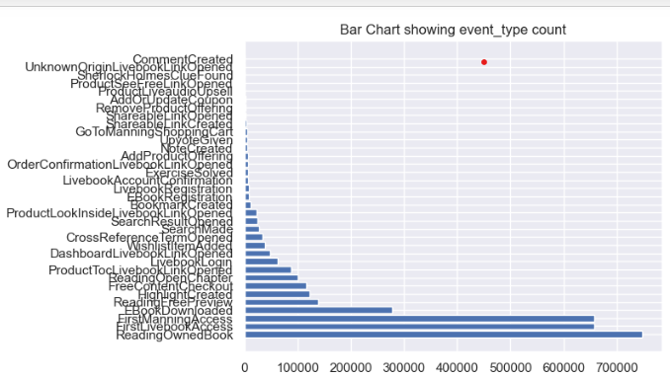
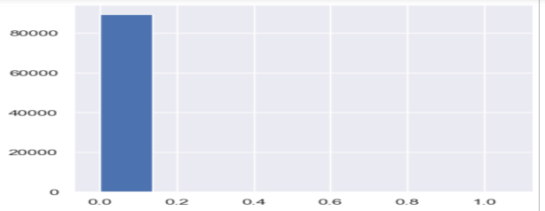
EXPLANATORY ANALYSIS To understand customer engagement, we analyzed several time series indicators. Let's take a look at some of the key findings:
1. What events are most and least common events : Reading owned book appears to be the most common event with the total number of 748,260 ( Seven hundred and forty eight thousand, two hundred and sixty) while comment created was the least with just 1 (one) comment created by a participant. This shows that so many people read there own book. The below graph gives a clear visualization;
2. The account_id with the highest and lowest number of events : The account_id with the highest event number is 6bb61e3b7bce0931da574d19d1d82c88 with a total number of 1,371,593 (one million, three hundred and seventy one thousand, five hundred and ninety three) and the account_id with the least event is 3519f4939d54c1911afa74226a78c3f9 with the total number of 1(one) participant. The below graph gives a clearer understanding of the event:

Slide 4
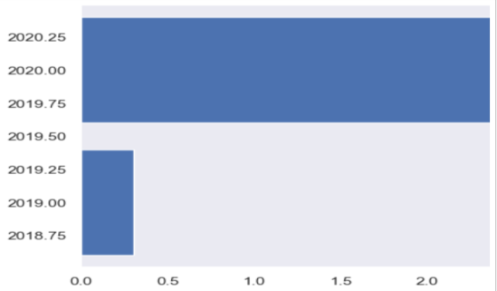
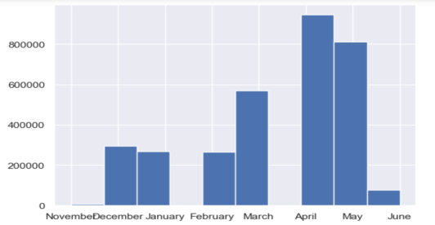
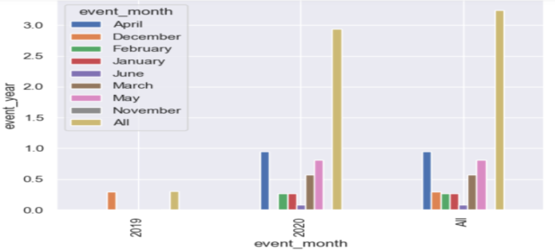
3. The number of times events occurred based on the following parameters: a. Yearly Activity: Based on the dataset it shows that the event occurred between two years (2019 – 2020) with the highest event occurrence in the year 2020 and the least occurrence in 2019 this may be due to the lockdown when people tend to engage with online reading. A graph to show the comprehensive insight. b. Monthly Activity: The analysis shows that the event occurs within some months of the year. Based on the analysis done it shows that the online book subscription starts towards the end of 2019 December and took its peak around April 2020 with highest number of engagement of 946,620 (nine hundred and forty six thousand, six hundred and twenty) and least event in November 2020 which is 7,309 (Seven thousand, three hundred and nine). This may be as a result of the peak period of lockdown due to COVID-19. The graph below shows the insight of the analysis. c. Weekly Activity: The event occurs throughout the days of the week with the highest event on Monday with the value of 511,433 (five hundred and eleven thousand, four hundred and thirty three) and the least event occurs on Saturday with the values of 362,201 (three hundred and sixty two thousand, two hundred and one). This is possible because there are more engagement on first working day of the week and since people could not go to work as a result of the lockdown people tend to engage with online activities which include reading. The graph below gives a more insight.

Slide 5
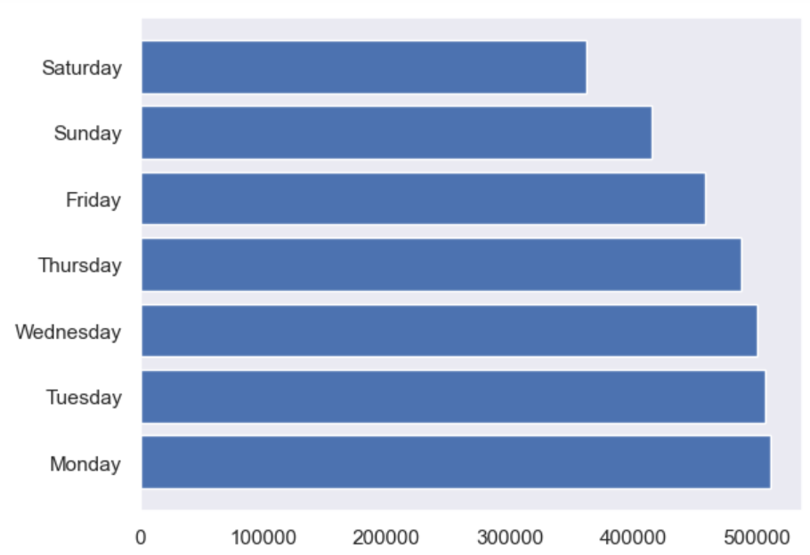
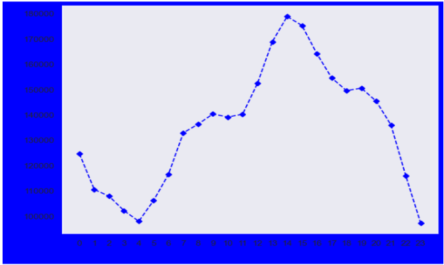
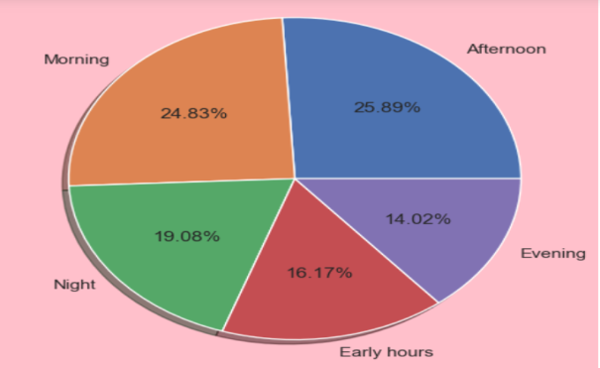
4. THE PERIOD OF THE DAY AND THE HOURS SPENT: It was discovered that 25.89% people got engaged mostly in the afternoon with the population of 839,437 (eight hundred and thirty nine thousand, four hundred and thirty seven) and the peak hours is between 14:00 and 15:00 (2:00pm-3:00pm) While the least occurrence period takes place in the evening. It shows that only 14.02% people got engaged with the total number of 454,549 (four hundred and fifty four thousand, five hundred and forty nine)This is possible because people tend to relax in the morning and put all engagement in the afternoon since they work remotely during the lockdown. Below are the graphs for better insight. 5. ENCODING; I use the feature-engine encoder to perform data encoding on my data features. 6. FORCASTING USING SUPERVISED MACHINE LEARNING: Out of all the machine learning algorithm that I tried for both time series algorithm and supervised machine learning, some gave inaccurate results. This may be due to the type of dataset, because only few ones were able to bring out a close result. The breakdown are given below with there graphs: a. TIME SERIES :My evaluation shows that: LINEAR REGRESSION; MEA(Mean Absolute Error): 0.0155900 MAPE(Mean Absolute Percentage Error): 1.824037 MSE(Mean Squared Error): 0.841671

Slide 6
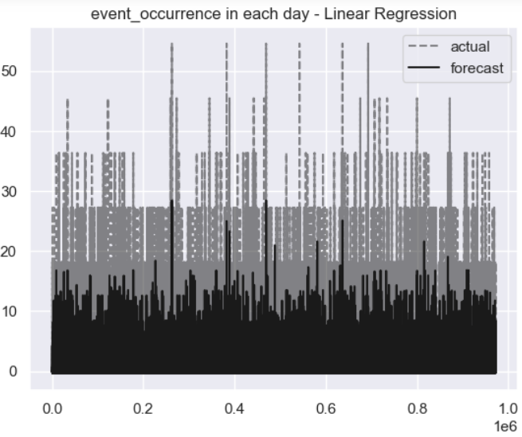
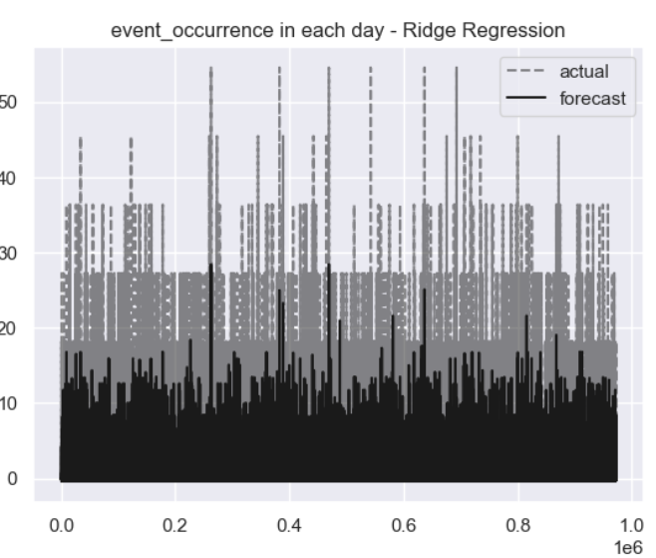
HUBER REGRESSION; MEA(Mean Absolute Error): 0.330921 MAPE(Mean Absolute Percentage Error): 4.519915 MSE(Mean Squared Error): 0.996598 NOTE: The above shows that the MSE is doing a very great job because the nearer to zero the result the better. This is the result of the difference between the actual value from the forecast value. b. SUPERVISED MACHINE LEARNING FORCAST: My evaluation shows the following: XGBOOST REGRESSOR: Train r2 score: 0.24730431125699393 Test r2 score: 0.2222577413314497 train_mse1: 0.7526956887430063 test_mse1: 0.7777422586685502 RANDOMFORESTREGRESSOR: Train r2 score: 0.2745029117650465 Test r2 score: 0.253760262405459 train_mse1: 0.7254970882349537 test_mse1: 0.7462397375945409 NOTE: The above result shows the percentage of the train and test of the dataset trained by the above model regressors. This does not really show a very good result and this may be due to: the type of data we are working with, the circumstances surrounding this data, and the period of the event which is the lockdown due to the COVID-19 crisis.

Slide 7
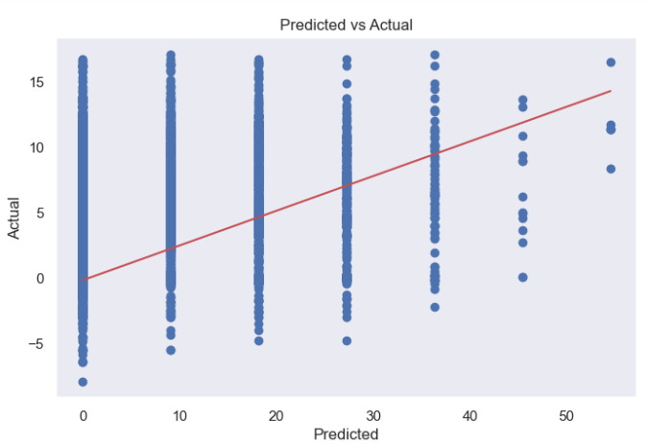
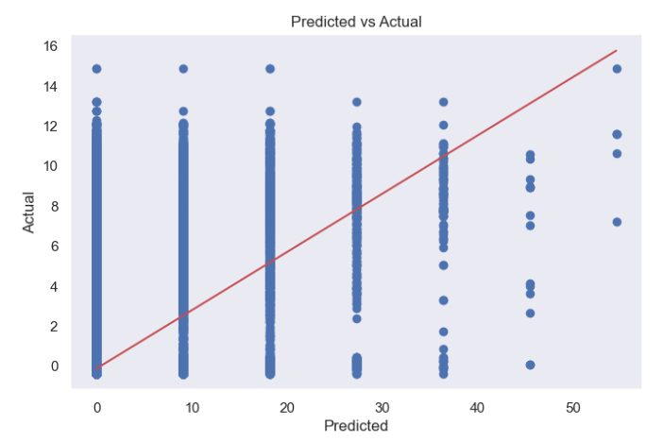
XGBOOST REGRESSOR RANDOMFORESTREGRESSOR XGBOOST REGRESSOR RANDOMFORESTREGRESSOR OTHER ANALYSES PERFORMED ON THE DATASET SQL: I was able to perform an SQL aggregation on the data to get an overview of what events are in the database by answering the following questions using SQL Queries: • The most common.• The least common.• The account id with the highest number of events. • The account id with the least number of events.• Times events occurred based on different times of the day. GITHUB: I was able to create a repo for my project in my github account and you can get it through: https://github.com/Davisfavour/my-first-project/blob/d1dd1427ccccdd621b4df5a374a0af254b404031/MY%20PROJECT%20(1)%20(1).ipynb PORTFOLIO: https://github.com/Davisfavour/Davisfavour.github.io.git CONCLUSION: In conclusion, our data analysis revealed valuable insights into customer engagement with our online books subscription service. By leveraging time series indicators and predictive analysis, we gained a deeper understanding of subscription trends and customer preferences, which can inform our business strategies moving forward. With continued growth in subscriptions and targeted marketing efforts, we are confident in the future success of our online books subscription service.

